Slide 1
Machine Learning
Support Vector Regression

Slide 2
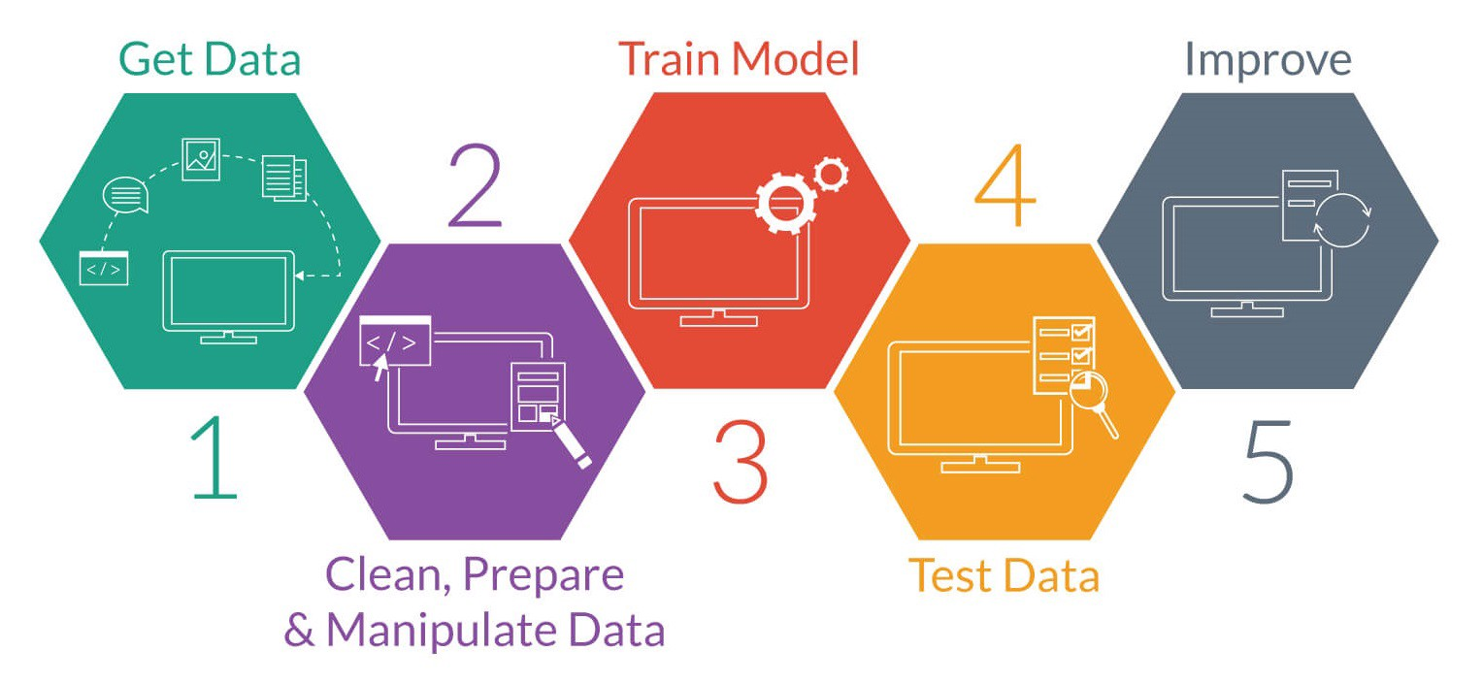
What is Machine Learning
That is means, machine learning is about the construction and study of systems that can learn from data. This is very different than traditional computer programming.

Slide 3
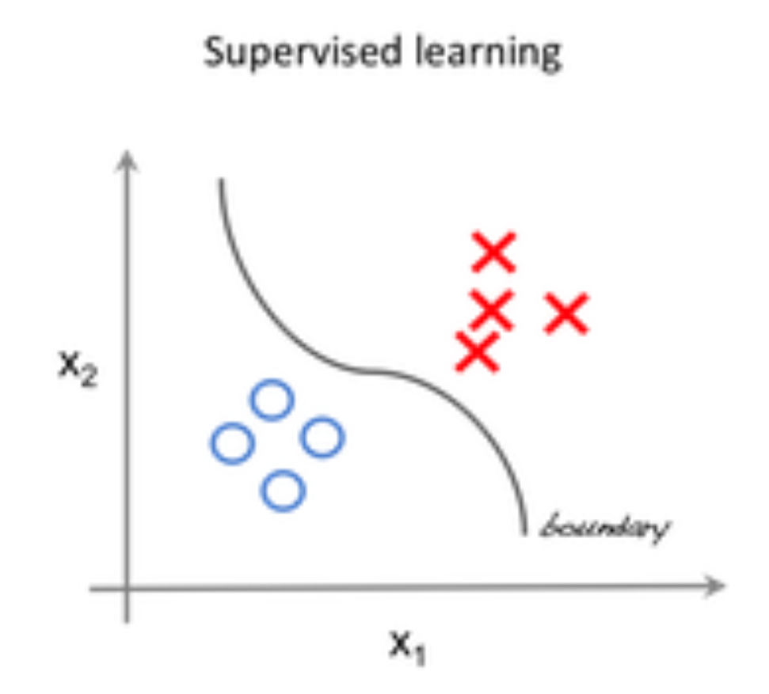
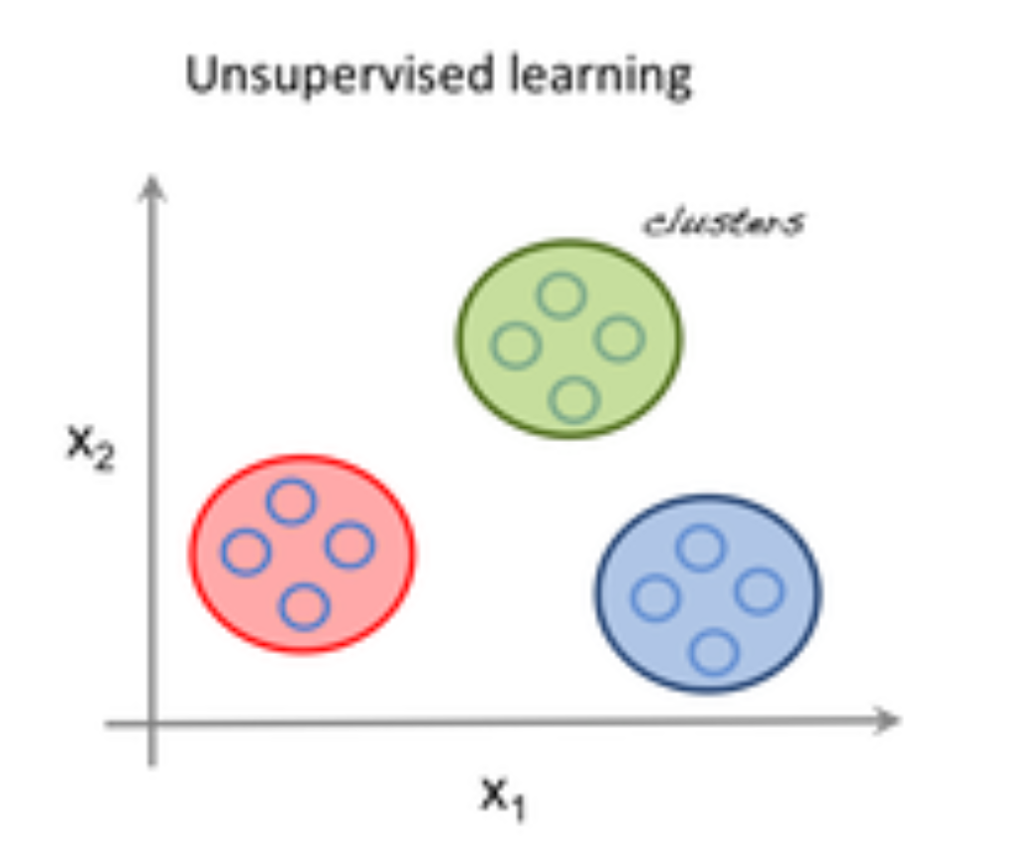
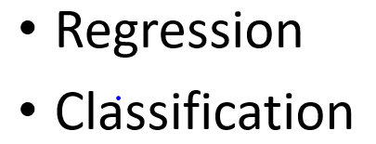
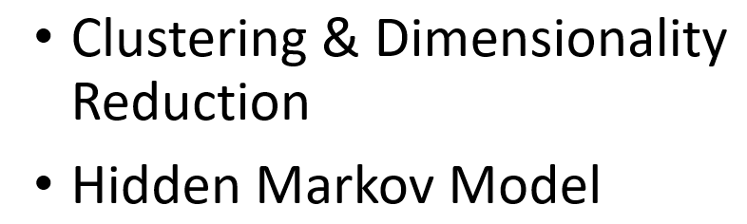
Field of Machine Learning
Supervised learning is one of the methods associated with machine learning which involves allocating labeled data so that a certain pattern or function can be deduced from that data.
Unsupervised learning is the second method of machine learning algorithm where inferences are drawn from unlabeled input data.

Slide 4
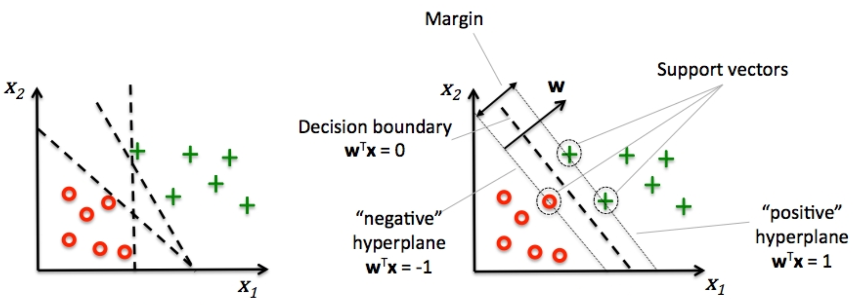
Support Vector Machine:
Classification

Slide 5
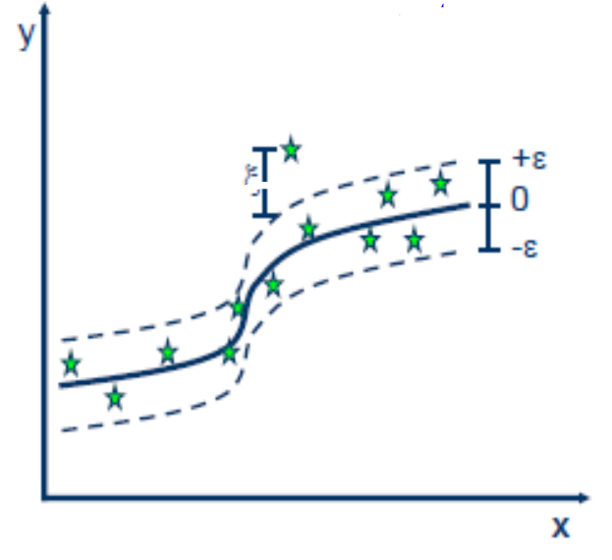
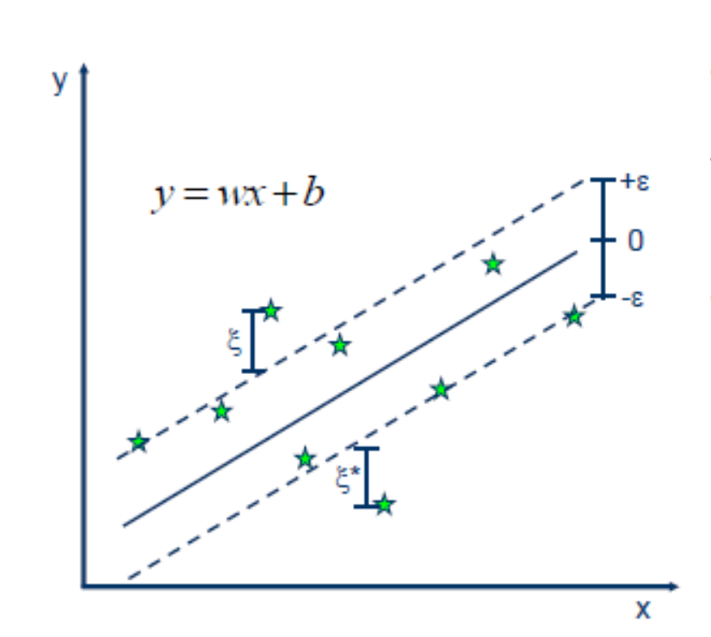
Support Vector Machine:
Regression
Linear Vs Non-Linear

